Slide 1
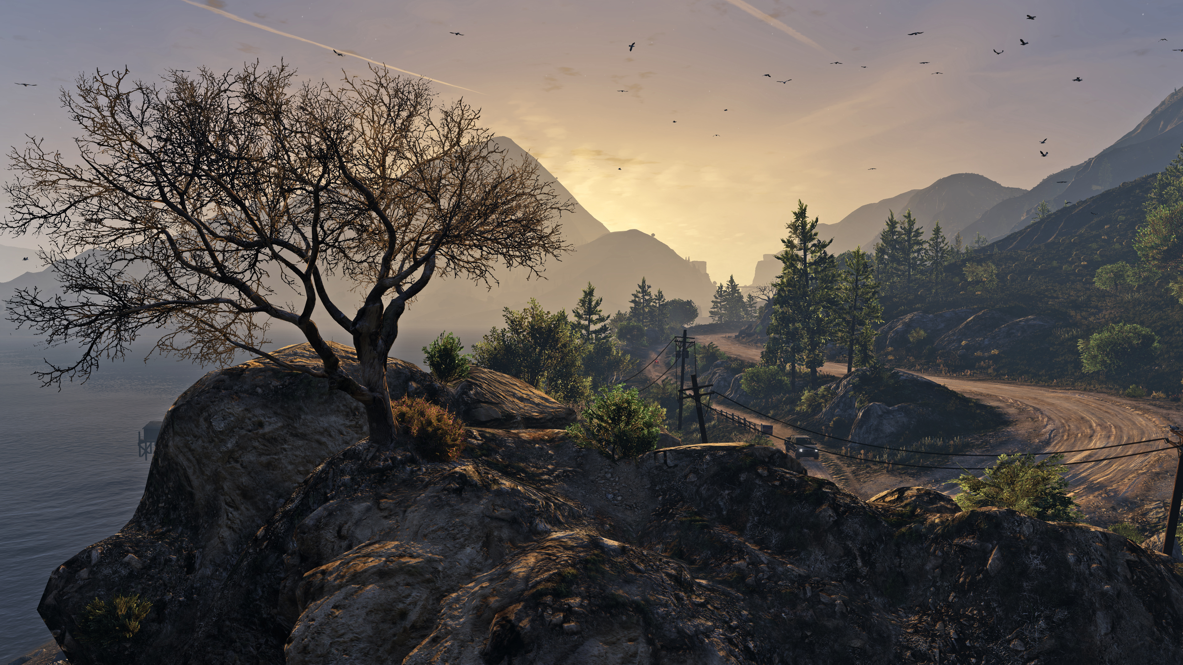
Game HoUse
OOPs Project
Our Team:
Maruthi Sai Sasank [AP22110011297]
Venkata Krishna Kashyap [AP22110011283]
B Navaneeth Krishna [AP22110011253]

Slide 2
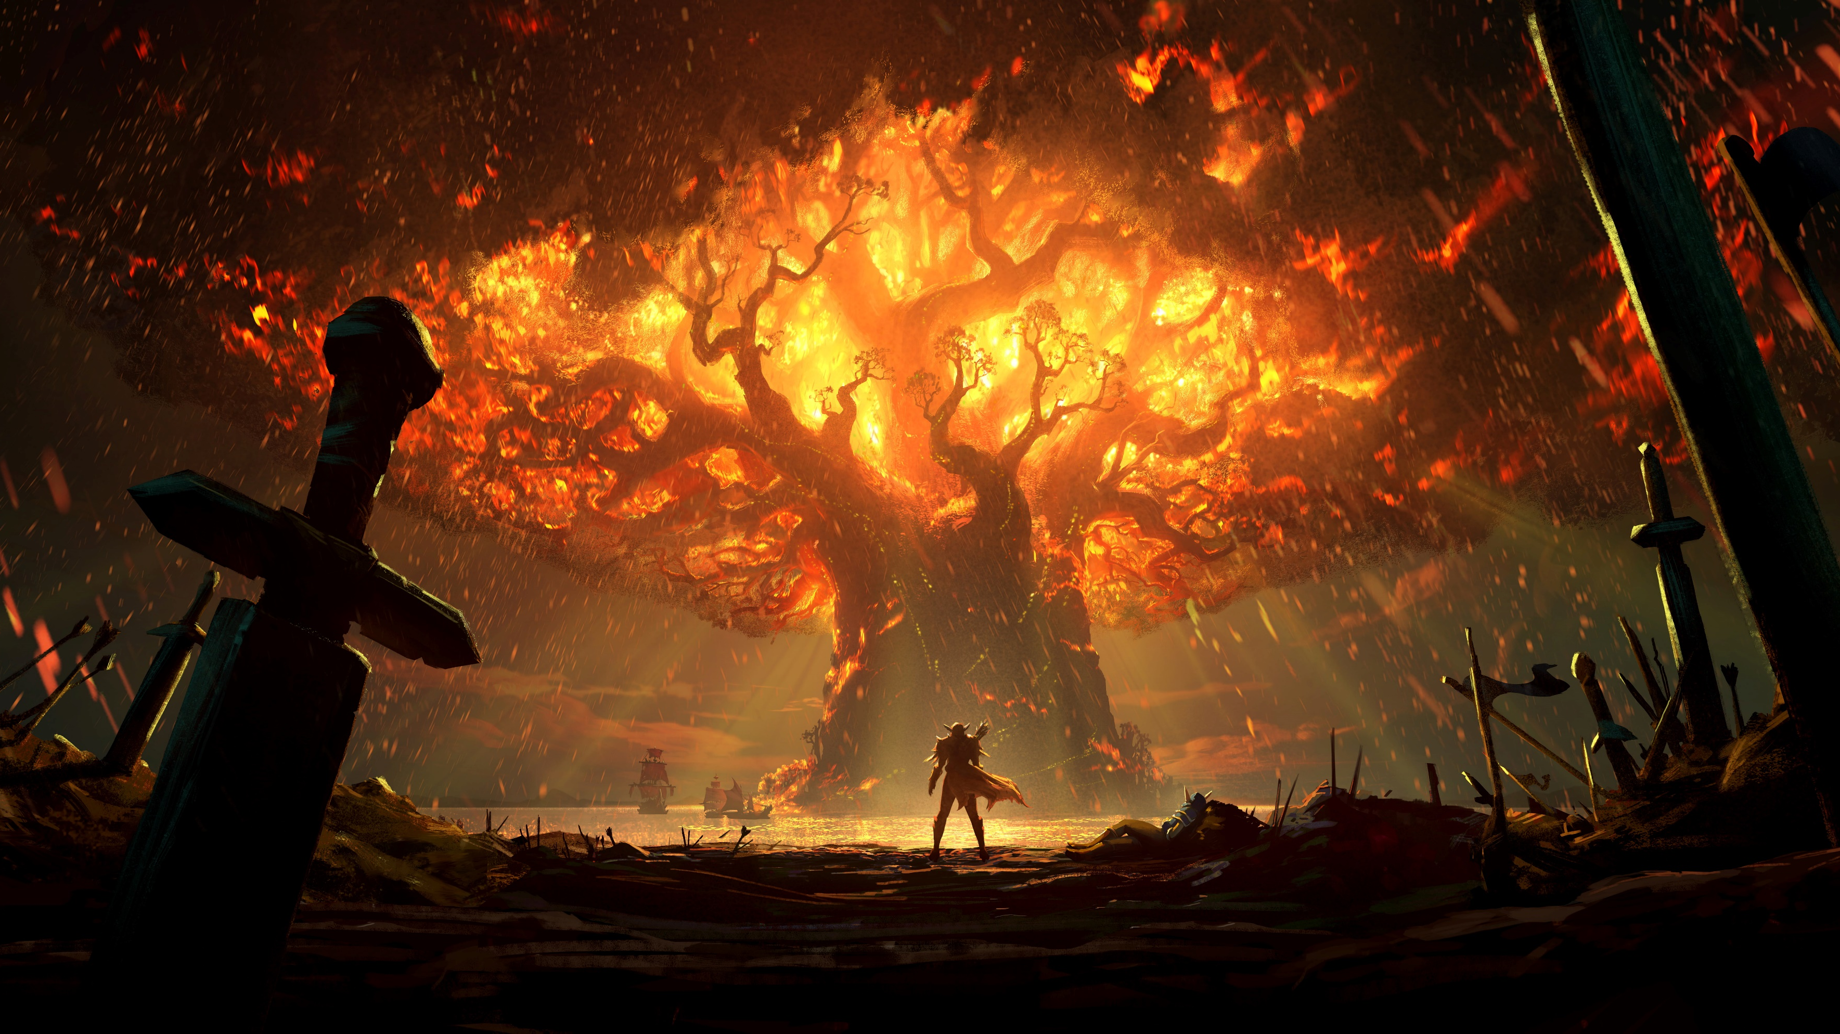
What Is ‘Game HoUse’!
The Game House project’s main objective was to create an entertaining platform which has a collection of the classic games.
The key aim is to showcase how Object-Oriented Programming (OOP) principles can be seamlessly integrated into real-time game development.
In addition, it offers users seamless transitions between different games, providing an effortlessly navigable environment that enhances the overall gaming experience.

Slide 3
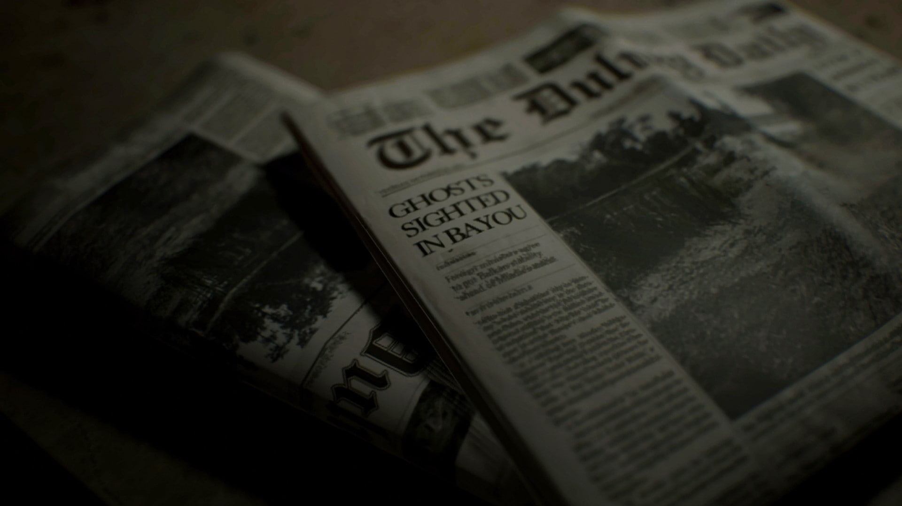
sUdoKU
Sudoku, a number puzzle, engages players in a grid of logic, requiring the strategic placement of numbers from 1 to 9 to fill every row, column, and 3x3 subgrid.
Beyond its numeric surface, Sudoku challenges the mind, demanding logical deduction and pattern recognition to complete the puzzle without repetition.
With its simple rules and endless complexity, Sudoku's universal appeal transcends language barriers, offering a satisfying mental challenge to players worldwide.

Slide 4

SNaKe aND laDDers
A dice-driven journey of climbs and setbacks, this timeless board game combines luck and strategy as players ascend ladders and navigate the twists of snake encounters.
Anticipate climbs, face setbacks – a thrilling game keeping players on the edge.
A timeless family favorite, Snake and Ladders transcends generations, providing a simple yet thrilling way for families and friends to bond over laughter and friendly competition.

Slide 5

Chess
The timeless game unfolds on a 64-square battlefield, challenging players strategically to outmaneuver and capture the opponent's king.
Beyond its regal ambiance, chess is an intellectual pursuit, demanding foresight, planning, and adaptability as players navigate openings, middlegames, and endgames.
Universally recognized, chess is a global language fostering camaraderie and competition while developing analytical thinking and problem-solving skills.

Slide 6

Tic tac toe
This classic game, played on a 3x3 grid, pits two opponents against each other in a race to align three symbols horizontally, vertically, or diagonally.
Despite its simplicity, Tic Tac Toe demands strategic thinking as players aim to outmaneuver their opponent, making it a quick yet engaging intellectual challenge.
Known for its rapid gameplay, Tic Tac Toe provides instant gratification, making it a go-to choice for quick bouts of fun and competition.

Slide 7
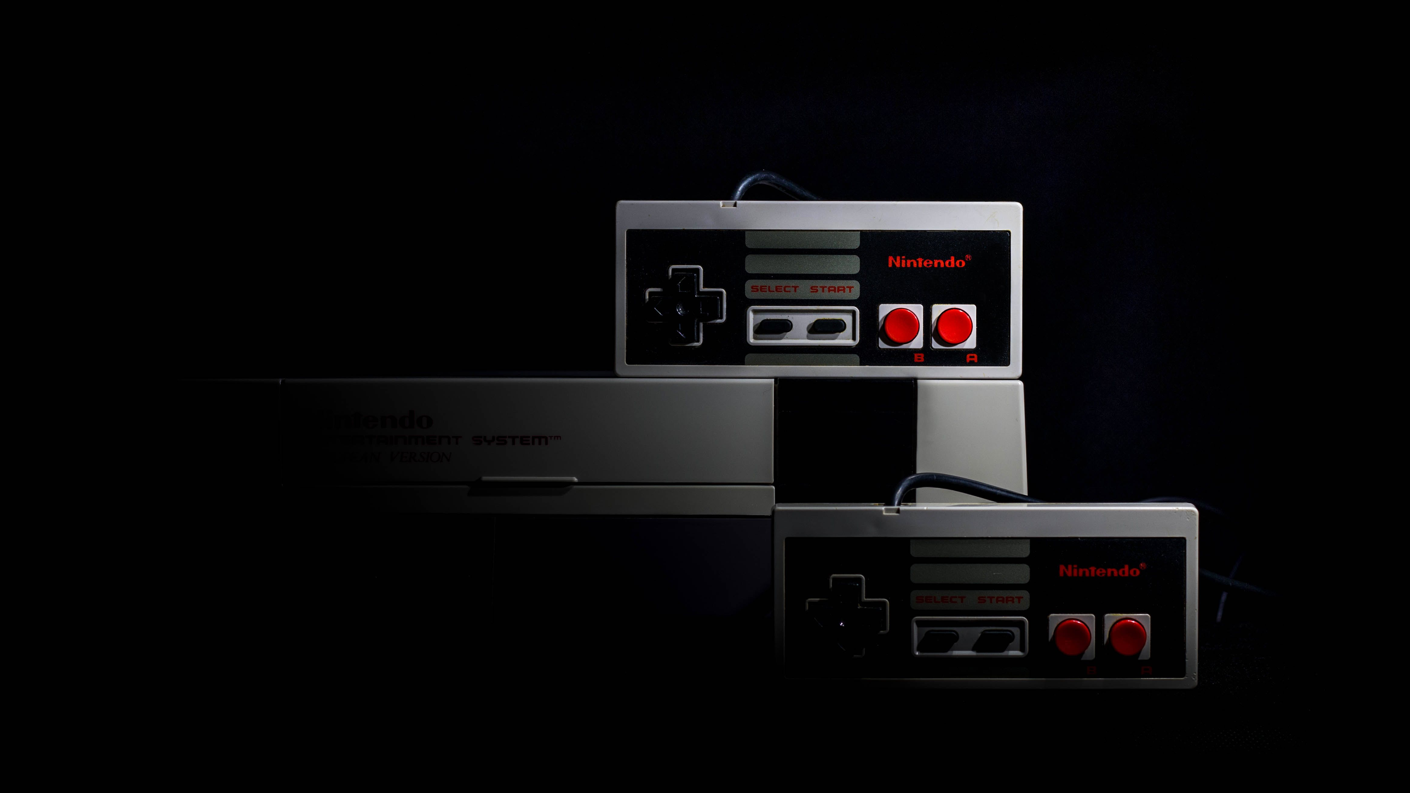
coNclUsioN
The Game House project delivers an entertaining platform with a diverse collection of classic games.
In conclusion, the Game House project has successfully achieved its primary goal of crafting an engaging platform that houses a rich collection of classic games.
Beyond mere entertainment, the project has also served as a powerful demonstration of the effective integration of OOPs principles into real-time game development.

